Slide 1
Using DICE Cluster
CSC 4760 / 6760 Big Data Programming
Spring 2018

Slide 2
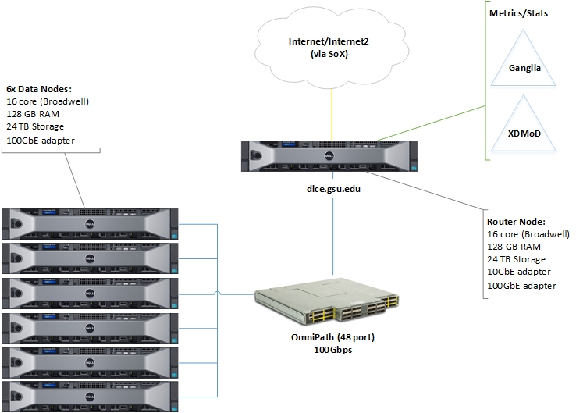
Hadoop/Spark Platform at GSU
Data Intensive Computing Environment (DICE)
https://researchsolutions.atlassian.net/wiki/display/PD/DICE
Request a Dice Account
Get it in 24 hours
Go to https://dice.gsu.edu:8000
Pick Files >> New >> Apache Torri Pyspark notebook

Slide 3
DICE
DICE Specifications are as follows:
CentOS 7.2 64-bit
Hadoop/Spark Ecosystem
1 x Dell PowerEdge 730
16 core (Broadwell), 2x Intel Xeon E5-2620 v4
128 GB RAM
24 TB NLSAS
10 GbE adapter
100 Gbps IB adapter
6 x Dell PowerEdge 730
16 core (Broadwell), 2x Intel Xeon E5-2620 v4
128 GB RAM
24 TB NLSAS
100 Gbps IB adapter

Slide 4
The DICE Cluster
Email from hpctech@rs.gsu.edu
One account has been created for each student.
UserID: campusID
Password: Your password for your campusID
To access DICE, please refer to out links below:
DICE remote shell access:
https://dice.gsu.edu:8000/hub/login
DICE Data Intensive tools:
https://dice.gsu.edu/#/main/dashboard/metrics
Join DICE user group:
https://gsu-bdwg.slack.com/messages/@slackbot/
Knowledge Base:
https://researchsolutions.atlassian.net/wiki/display/PD/DICE

Slide 5
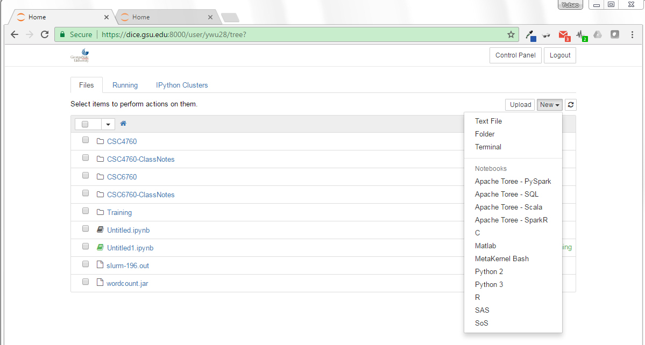
Run Hadoop on the DICE Cluster
DICE remote shell access:
https://dice.gsu.edu:8000/hub/login
Click on “New” => MetaKernel Bash

Slide 6
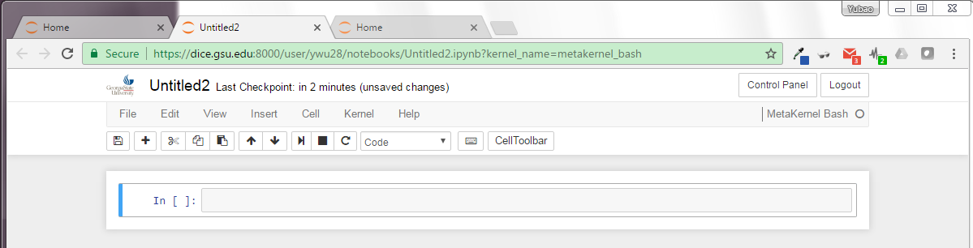
Run Hadoop on the DICE Cluster
Input your command to run Hadoop.
For example, type “hadoop version”

Slide 7
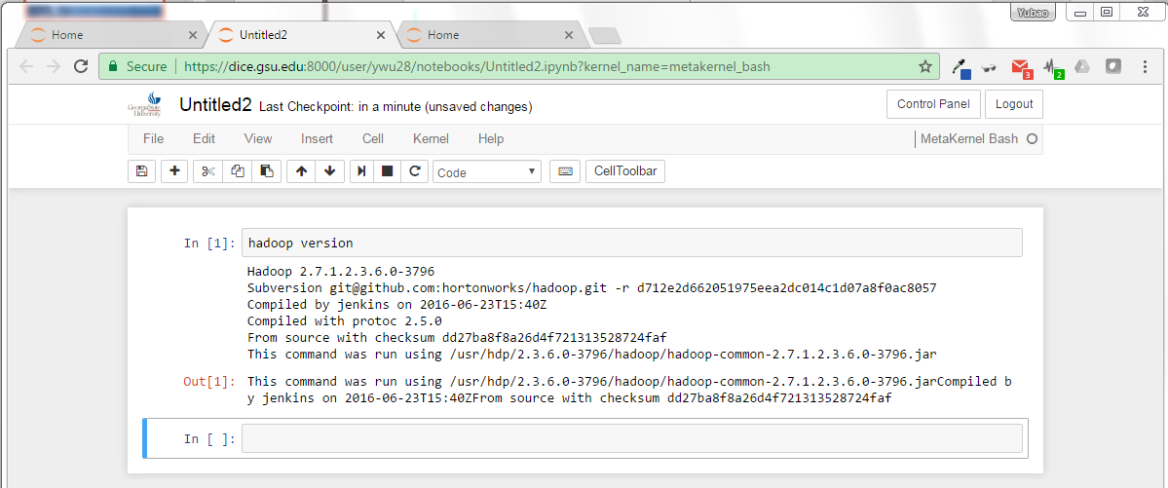
Run Hadoop on the DICE Cluster
Input your command to run Hadoop.

Slide 8
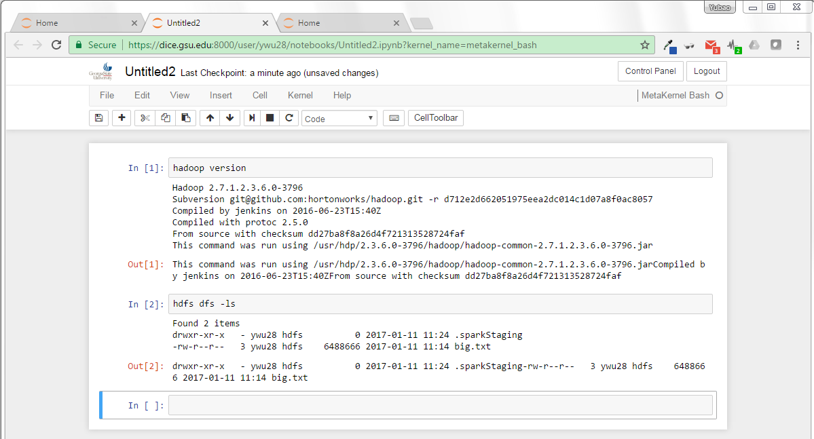
type “hdfs dfs -ls”

Slide 9
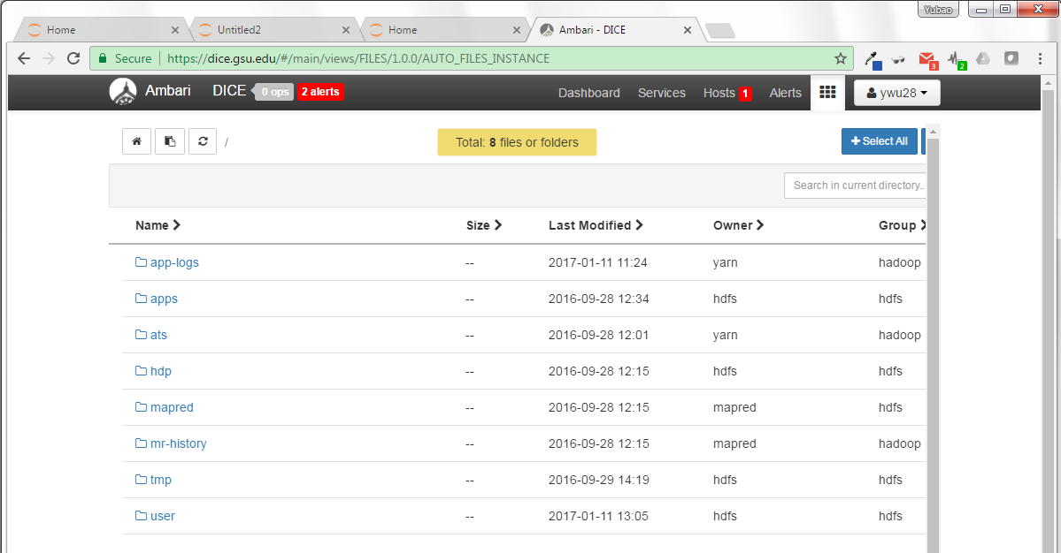
How to upload a dataset file to the local FS in the DICE Cluster?
Click “file view”!
Upload to the local FS in DICE.
Click “User”-> click your name!

Slide 10
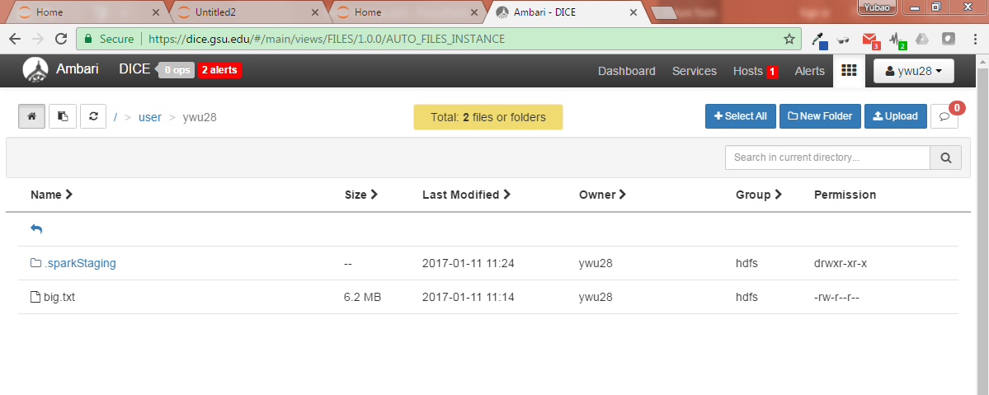
How to upload a dataset file to the HDFS in the DICE Cluster?
Upload to the HDFS in DICE.
Click “Upload”-> your data file!

Slide 11
How to run Hadoop job
Type your source code in a Java IDE (like Eclipse Java)
Use Java IDE (like Eclipse Java) to create a “.jar” file
Upload the “.jar” file into the local FS of DICE
Type “hadoop jar …” to run it.

Slide 12
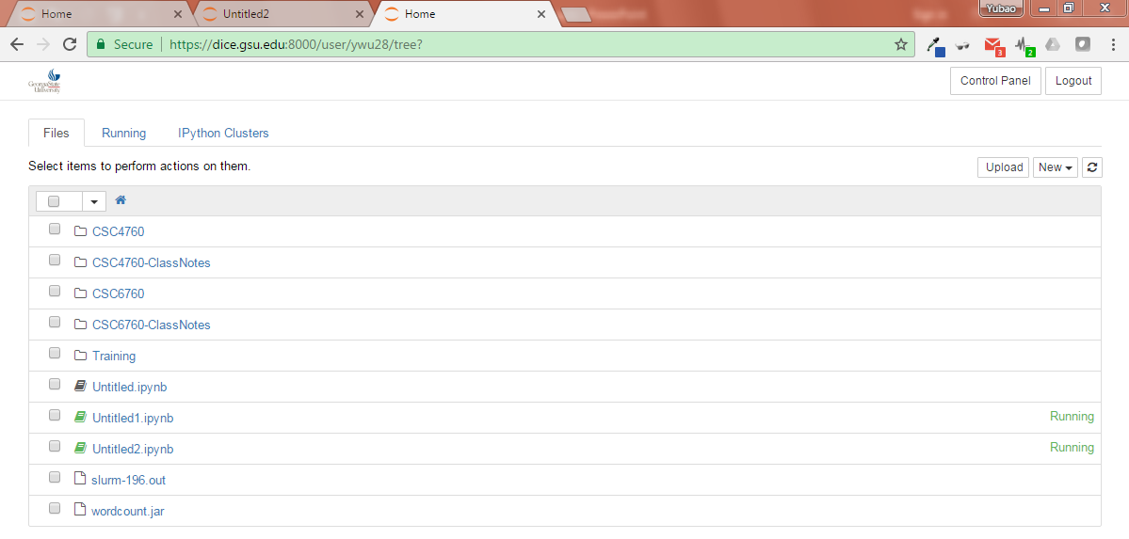
Upload a “.jar” file to DICE
Click “Upload”-> your .jar file!

Slide 13
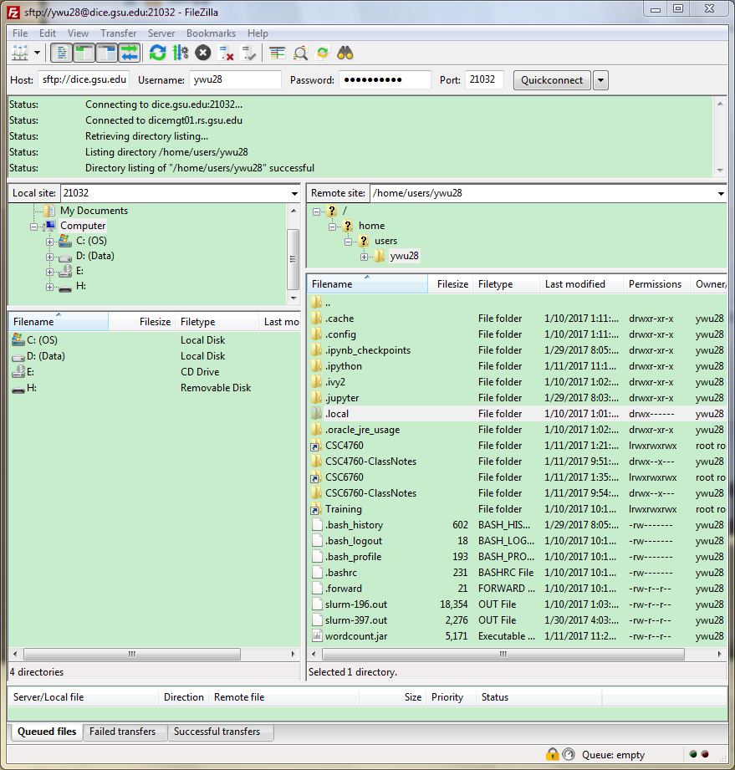
Upload a “.jar” file to DICE by Using FileZilla (SSH)
1. Download FileZilla (https://filezilla-project.org/download.php?type=client)
2. Host: sftp://dice.gsu.edu
3. Your User Name and Password
4. Port: 21032
5. Press “Quickconnect” button
Upload to the local FS in DICE.

Slide 14
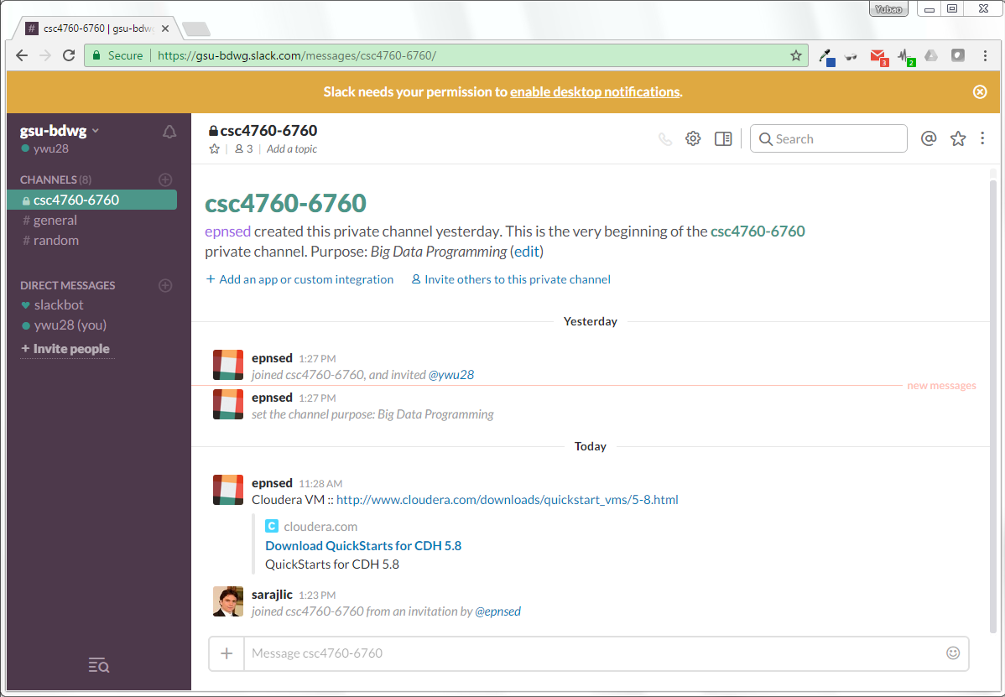
DICE User Group : the learning community

